Slide 1


School of Basic and Applied Sciences
Course Code : BBS01T1002 Course Name: Semiconductor Physics
Unit 2:
Types of Semiconductor
Name of the Faculty: Dr. Prabhakar Singh Program Name: B.Tech

Slide 2
Topics to be covered
Preliminary idea of semiconductors
Types of semiconductors
Intrinsic or pure Semi-Conductors:
Extrinsic or doped Semi-Conductors:
N-type semi-conductors:
P-type semi-conductors:
Practice Questions
References
Name of the Faculty: Dr. Aakash Mathur Program Name: B.Tech

Slide 3
Objectives
Learn basics of semiconductors
Classifications of semiconductors
Compare N-type and P-type semi-conductors, distinguishing them from semi-conductors and insulators using band theory.

Slide 4
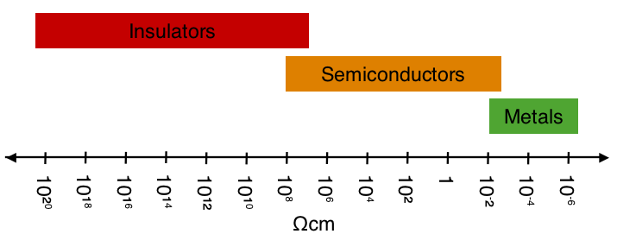
Prerequisite/Recapitulations
--
Semiconducting materials:
Semiconductors arc materials which have electrical conductivities lying between those of good conductors and insulators. The resistivity of semiconductors varies from 10⁻⁵ to 10⁺⁶ ohm-m as compared to the values ranging from 10⁻² to 10⁻⁸ ohm-m for conductors and from 10⁷ to 10¹⁹ ohm-m for insulators.
Another important characteristic of the semiconductors is that they have small band gap. The band gap of semiconductors varies from 0.2 to 2.S eV which is quite small as compared to that of insulators. The band gap of a typical insulator such as diamond is about 6 eV.
Name of the Faculty: Dr. Sanjeev Kumar Program Name: B.Tech

Slide 5
Introduction
The importance of semiconductors is further increased due to the fact that the conductivity and the effective band gaps of these materials can be modified by the introduction of impurities which strongly affect their electronic and optical properties. The process of introduction of impurities in semiconductors is called doping. Depending on the nature of impurities added, the semiconductors are classified as :
(a) Pure or intrinsic semiconductors
(b) Doped or extrinsic semiconductors
Name of the Faculty: Dr. Sanjeev Kumar Program Name: B.Tech

Slide 6
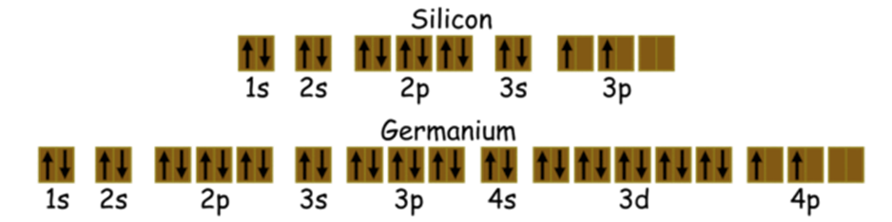
Intrinsic semiconductor:
The intrinsic semiconductors are pure semiconductors in which no impurity atoms are added. The most common intrinsic semiconductors are Silicon (Si) and Germanium (Ge), which belong to Group IV of the periodic table. The atomic numbers of Si and Ge are 14 and 32, which yields their electronic configuration as 1s² 2s² 2p⁶ 3s² 3p² and 1s² 2s² 2p⁶ 3s² 3p⁶ 4s² 3d¹⁰ 4p², respectively As shown in figure)
In intrinsic semiconductors the number of excited electrons and the number of holes are equal: n = p. e.g. Germanium and Silicon.

Slide 7
Intrinsic semiconductor:
This indicates that both Si and Ge have four electrons each in their outer-most i.e. valence shell (indicated by red colour). These electrons are called valence electrons and are responsible for the conduction-properties of the semiconductors.
The crystal lattice of Silicon (it is the same even for Germanium) in two-dimension . Here it is seen that each valence electron of a Si atom pair with the valence electron of the adjacent Si atom to form a covalent bond.
After pairing, the intrinsic semiconductor becomes deprived of free charge carriers which are nothing but the valence electrons. Hence, at 0K the valence band will be full of electrons while the conduction band will be empty (as shown in figure 2 , in next slide). At this stage, no electron in the valence band would gain enough energy to cross the forbidden energy gap of the semiconductor material. Thus the intrinsic semiconductors act as insulators at 0K.
Name of the Faculty: Dr. Sanjeev Kumar Program Name: B.Tech

Slide 8
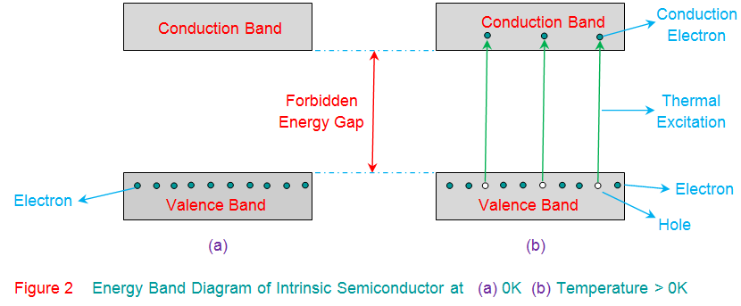
Intrinsic semiconductor:
However, at room temperature, the thermal energy may cause a few of the covalent bonds to break, thus generating the free electrons as shown in Figure 3a. The electrons thus generated get excited and move into the conduction band from the valence band, overcoming the energy barrier (Figure 2b). During this process, each electron leaves behind a hole in the valence band. The electrons and holes created in this way are called intrinsic charge carriers and are responsible for the conductive properties exhibited by the intrinsic semiconductor material.
Name of the Faculty: Dr. Sanjeev Kumar Program Name: B.Tech

Slide 9
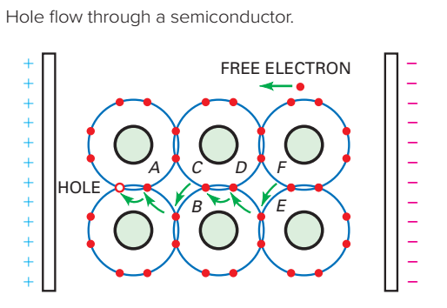
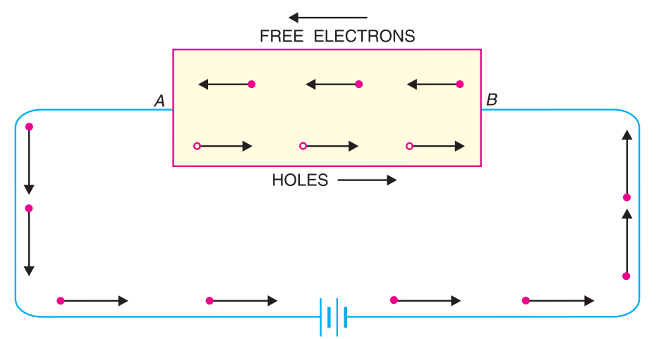
Intrinsic semiconductor:
In an intrinsic semiconductor, even at room temperature, hole-electron pairs are created Under the influence of electric field, conduction through the semiconductor is by both free electrons and holes. Therefore, the total current inside the semiconductor is the sum of currents due to free electrons and holes.
Name of the Faculty: Dr. Sanjeev Kumar Program Name: B.Tech

Slide 10
Extrinsic Semi-Conductors:
The impurity mixed intrinsic semi-conductors are called extrinsic semiconductor. The process of adding impurity is called doping. The purpose of adding impurities is either to increase the number of free electrons or holes in the semi-conductor crystal.
Depending on the type of impurity added, the extrinsic semi conductor are classified as:
N-type semi-conductors:
electrons are majority charge carriers.
This is achieved by doping with pentavalent impurity atoms such as Phosphorus.
P-type semi-conductors:
holes are majority charge carriers.
This is achieved by doping with trivalent impurity atoms such as Aluminium.
Name of the Faculty: Dr. Sanjeev Kumar Program Name: B.Tech

Slide 11
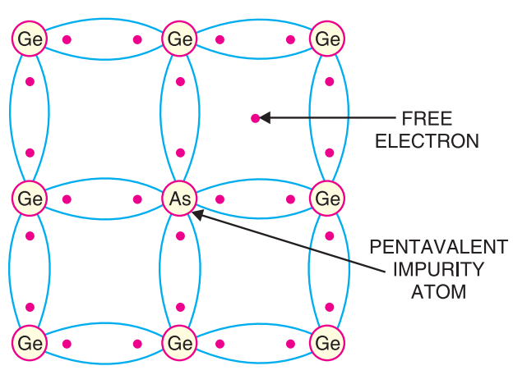
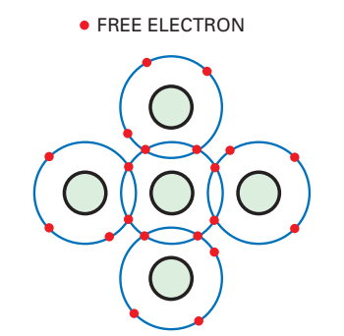
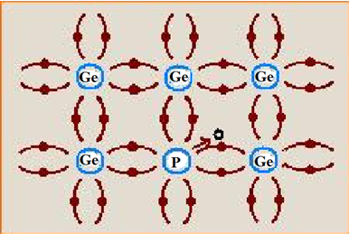
N-type semi-conductors:
When a small amount of pentavalent impurity (phosphorus, bismuth, arsenic, antimony) is doped in pure semi-conductor then the conductivity of crystal increases due to surplus electrons and such a doped semi-conductor is called N-type semi-conductors while the imputrity atoms are called donors, because they donate free electrons for conduction to the semiconductor crystal.
To explain the formation of N-type semiconductor, consider that a pentavalent impurity phosphorus is added to a pure germanium crystal. Each impurity atom with five valence electrons replaces a germanium atom. The four valence electrons of impurity atom form covalent bonds with electrons of neighbouring germanium atoms, while the fifth electron becomes surplus. Therefore for each impurity atom added one electron will be available for germanium crystal to cause conduction.
Name of the Faculty: Dr. Sanjeev Kumar Program Name: B.Tech

Slide 12
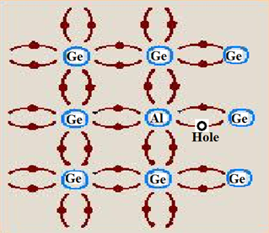
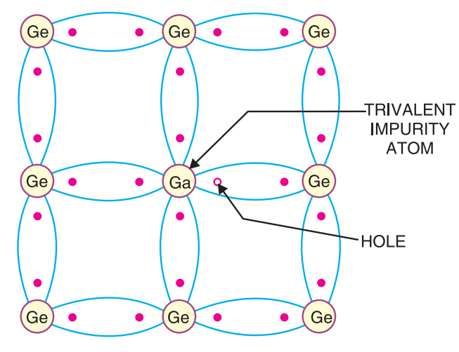
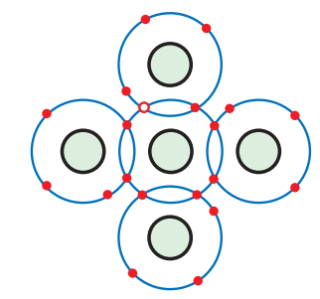
P-type semi-conductors:
When a small amount of trivalent impurity like gallium, indium, aluminium or boron is doped in a pure semi-conductor, then the conductivity of crystal increases due to the deficiency of electrons (i.e., holes) and such a doped semi-conductor is called P-type semi-conductors, while the impurity atoms are called acceptors because the holes created can accept the electrons.
To explain the formation of P-type semi-conductor, consider that a trivalent impurity (Aluminium or Ga) is added to pure germanium crystal. Each impurity atom with three valence electrons replaces a germanium atom . Three valence electrons of Aluminium can form only three single covalent bonds with neighbouring germanium atoms. In the formation of fourth covalent bond there is a deficiency of electron with Aluminium. This deficiency acts like a positive charge and is called a hole. Therefore for each impurity atom added, a hole is created. A small amount of trivalent impurity provides millions of holes to cause conduction.
Name of the Faculty: Dr. Sanjeev Kumar Program Name: B.Tech

Slide 13
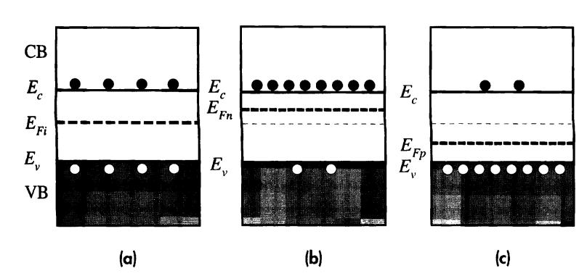
Energy band diagrams
Energy band diagrams for (a) intrinsic, (b) n-type, and (c) p-type semiconductors. In all cases, np = n²_{i}.
Name of the Faculty: Dr. Sanjeev Kumar Program Name: B.Tech

Slide 14
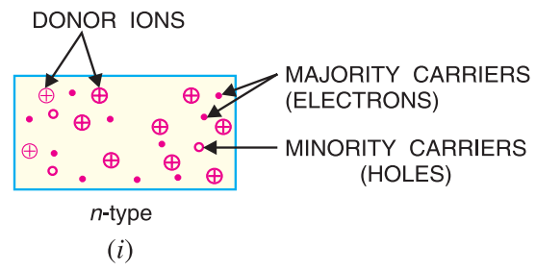
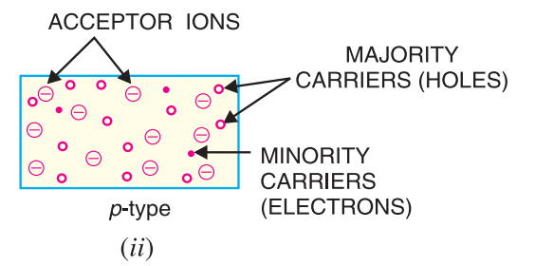
Majority and Minority Charge Carriers
Name of the Faculty: Dr. Sanjeev Kumar Program Name: B.Tech

Slide 15
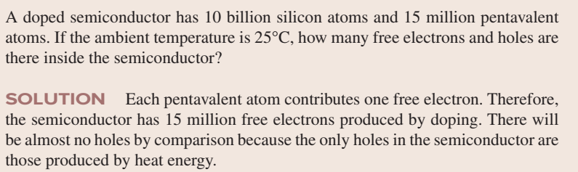
Practice Questions
Name of the Faculty: Dr. Sanjeev Kumar Program Name: B.Tech

Slide 16
Practice Questions
Define majority carriers and minority carriers
Discuss Semiconductors and their classifications.
3. Explain intrinsic semiconductors.
4. Illustrate extrinsic semiconductors with suitable diagram.
Name of the Faculty: Dr. Sanjeev Kumar Program Name: B.Tech

Slide 17
References:
1. J. Singh , Semiconductor optoelectronics, Physics and Technology, Mc-Graw –Hill Inc. 1995.
2. S.M. Sze, Semiconductor Devices: Physics and Technology, Wiley 2008.
3. Pillai S O, Solid State Physics,( 2010), sixth edition, New Age International (P) Ltd. ISBN-9788122427264.
4. https://www.youtube.com/watch?v=5ZNeDxfgYAE
Name of the Faculty: Dr. Sanjeev Kumar Program Name: B.Tech

